Slide 1


Sybex CCNA 640-802
Chapter 7: Managing a Cisco Internetwork
Instructor & Todd Lammle

Slide 2

Chapter 7 Objectives
Manage IOS configuration files (including: save, edit, upgrade, restore)
Manage Cisco IOS
Verify network connectivity (including: using ping, traceroute, and telnet or SSH)

Slide 3
Cisco Router Components
Bootstrap
  Brings up the router during initialization
POST
  Checks basic functionality; hardware & interfaces
ROM monitor
  Manufacturing testing & troubleshooting
Mini-IOS
  Loads Cisco IOS into flash memory
RAM
  Holds packet buffers, routing tables, & s/w
  Stores running-config

Slide 4
Cisco Router Components
ROM
  Starts & maintains the router
Flash Memory
  Holds Cisco IOS
  Not erased when the router is reloaded
NVRAM
  Holds router (& switch) configurations
  Not erased when the router is reloaded
Configuration Register
  Controls how the router boots up

Slide 5
Boot Sequence
1: Router performs a POST
2: Bootstrap looks for & loads the Cisco
IOS
3: IOS software looks for a valid
configuration file
4: Startup-config file (from NVRAM) is
loaded
  If startup-config file is not found, the router will start the setup mode

Slide 6
Configuration Register
Register
  16-bit number written into NVRAM
  Loads from flash memory & looks for the startup-config file
Configuration Register Bits
  16 bits read 15-0, from left to right
  default setting: 0x2102
Register 2 1 0 2
Bit number 15 14 13 12 11 10 9 8 7 6 5 4 3 2 1 0
Binary 0 0 1 0 0 0 0 1 0 0 0 0 0 0 1 0
NOTE: 0x means the digits that follow are in hexadecimal

Slide 7
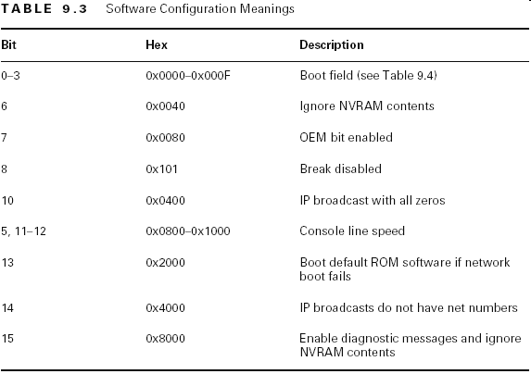
Configuration Meanings

Slide 8
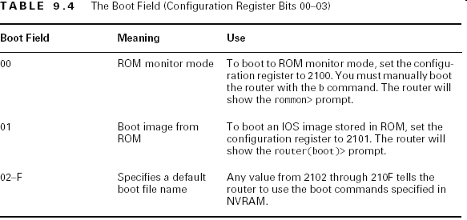
Boot Field Meanings

Slide 9
Checking the Register Value
Router#sh version
Cisco Internetwork Operating System Software
IOS ™ C2600 Software (C2600-I-M), Version 12.0(3)T3
RELEASE SOFTWARE (fc1)
[output cut]
Configuration register is 0x2102

Slide 10
Changing the Configuration Register
Force the system into the ROM monitor mode
Select a boot source & default boot filename
Enable or disable the Break function
Set the console terminal baud rate
Load operating software from ROM
Enable booting from a TFTP server

Slide 11
Changing the Configuration Register
Router(config)#config-register 0x0101
Router(config)#^Z
Router#sh ver
Configuration register is 0x2102 (will be 0x0101 at next reload)

Slide 12
Recovering Passwords
1: Boot the router & interrupt the boot sequence by performing a break
2: Change the configuration register to turn on bit 6 (0x2142)
3: Reload the router
4: Enter the privileged mode
5: Copy the startup-config to running-config
6: Change the password
7: Reset the configuration register to the default value
8: Reload the router

Slide 13
Recovering Passwords
1: Boot the router & interrupt the boot sequence by performing a break using the Ctrl+Break key combination.
You may need to upgrade your version of hyper-terminal in order for this to work successfully.

Slide 14
Recovering Passwords
2: Change the configuration register to turn on bit 6 (0x2142)
  rommon>confreg 0x2142
  You must reset or power cycle for new config to take effect
3: Reload the router
  Type reset
    The router will reload & ask if you want to enter setup mode
      Answer NO
4: Enter the privileged mode
    Router>enable
    Router#

Slide 15
Recovering Passwords
5: Copy the startup-config to running-config
    Router#copy startup-config running-config
6: Change the password
    Router#config t
    Router(config)#enable secret cisco
7: Reset the configuration register to the default value
    Router(config)#config-register 0x2102
8: Reload the router

Slide 16
Backing up & Restoring the Cisco IOS
Before you upgrade…..
  Copy the existing IOS to a TFTP host!
Verify Flash Memory
    Router#sh flash
    System flash directory:
    File Length Name/status
    1 8121000 c2500-js-1.112-18.bin
    [8121064 bytes used, 8656152 available, 16777216 total]
    16384K bytes of processor board System flash (Read ONLY)
    Router#

Slide 17
Backing up the Cisco IOS
#1: Ensure you have good connectivity to the TFPT host
    Router#ping 192.168.0.120
#2: Copy the IOS from flash to the TFTP
host
    Router#copy flash tftp
    The TFTP host must have a default directory specified

Slide 18
Restoring or Upgrading the Cisco IOS
#1: Ensure you have good connectivity to the TFTP host
Router#ping 192.168.0.120
#2: Copy the IOS from the TFTP host to flash
    Router#copy tftp flash
    The TFTP host must have a default directory specified
    Copying the IOS from a TFTP host to flash requires a router reboot

Slide 19
Backing up the Configuration
1: Verify the Current Configuration
    Router#sh run
2: Verify the Stored Configuration
    Router#sh start
      Verify available memory
3: Copy running-config to NVRAM
    Router#copy run start
    Router#sh start
4: Copy running-config to a TFTP host
    Router#copy run tftp
      A second backup

Slide 20
Restoring the Configuration
Used when…
  You need to copy the startup-config to the running-config
    Errors made in editing the running-config
  Changes made at the TFTP host need to be copied to the running-config or startup-config
  Router#copy tftp run or Router#copy tftp start
    NOTE: The configuration file is ASCII. Any text editor will enable changes
Erasing the Configuration
  Router#erase startup-config
  Note: When the router reboots it will be in setup mode

Slide 21
TFTP
Trivial File Transfer Protocol
Does not have all the fancy features of FTP
Default port: 69
Uses UDP as a transport protocol
Does the sequence numbers and ACKs at the application layer

Slide 22
Using Cisco Discovery Protocol (CDP)
A Cisco proprietary protocol
  Designed to collect information about directly attached & remote devices
    Hardware information
    Protocol information
  Useful in troubleshooting & documenting the network

Slide 23
Getting CDP Timers & Holdtime Information
Configuration
  CDP Timer: How often CDP packets are transmitted to all active interfaces
  CDP Holdtime: The amount of time that the device will hold packets received from neighbor devices
      Router#sh cdp
      Global CDP information
      Sending CDP packets every 60 seconds
      Sending a holdtime value of 180 seconds
      Router#config t
      Router(config)#cdp timer 90
      Router(config)#cdp holdtime 240

Slide 24
Getting Neighbor Information
Shows information about directly connected devices
  CDP packets are not passed through a Cisco switch
  Can only see what is directly attached
    Router#sh cdp nei
    or
    Router#sh cdp neighbor detail
      Detailed information; hostname, IP address, etc

Slide 25
Getting Interface Traffic & Port Information
Interface Traffic Information:
  CDP packets sent & received
  Errors with CDP
    Router#sh cdp traffic
Port & Interface Information:
  Encapsulation on the line
  Timer & Holdtime for each interface
    Router#sh cdp interface

Slide 26
Using Telnet
A virtual terminal protocol
  Part of the TCP/IP suite
  Allows connections to remote devices
    Gather information
    Run programs
  Note: The VTY passwords must be set on the routers

Slide 27
Using Telnet
Setting VTY passwords:
  Router#config t
  Router(config)#line vty 0 4
  Router(config-line)#password cisco
  Router(config-line)#login
  Router(config-line)#^Z
  Router#172.16.10.2
  Trying 172.16.10.2 … Open
  User Access Verification
  Password:
  RouterB>

Slide 28
Using Telnet
Setting VTY password:
  Router#config t
  Router(config)#line vty 0 4
  Router(config)#login
  Router(config)#password cisco
  Router(config)#^Z
  Router#172.16.10.2
  Trying 172.16.10.2 … Open
  User Access Verification
  Password:
  RouterB>
  Remember….
  VTY password is the user mode (>) password - not the enable mode (#) password
  With no enable/enable secret password set, the following happens:
    RouterB>en
    % No password set
    RouterB>
  This equates to good security!

Slide 29
Telnet Commands
Telnetting into Multiple Devices
    Ctrl+Shift+6 (release) X
Checking Telnet Connections
    Router#sh sessions
Checking Telnet Users
    Router#sh users
Closing Telnet Sessions
    RouterB>exit
    RouterB>disconnect

Slide 30
Resolving Hostnames
To use a hostname rather than an IP address to connect to a remote host a device must be able to translate the hostname to an IP address
  Build a host table on each router
  Build a Domain Name System (DNS) server

Slide 31
Building a Host Table
Provides name resolution only on the router on which it is built
    ip host host_name [tcp_port_number] ip_address
    Router(config)#ip host RouterB 172.16.10.2
    Router(config)#ip host switch 192.168.0.148
    Router#sh hosts
    Default TCP port number: 23
    Router#RouterB
    RouterB#(Ctrl+Shift+6) (X)
    Router#switch

Slide 32
Using DNS to Resolve Names
Used when you have many devices on your network
Making DNS work…
  ip domain-lookup
    Turned on by default
  ip name-server
    Sets the IP address of the DNS server (up to 6 each)
  ip domain-name
    Appends the domain name to the hostname
      Ex: RouterA.neversail.navy.mil

Slide 33
Checking Network Connectivity
Ping
  Displays the minimum, average, & maximum times it takes for aping packet to find a specified system + return
      Router#ping RouterB
Trace
  Shows the path a packet takes to get to a remote device
      Router#trace RouterB

Slide 34
Summary
Go through all the written and review questions
Go through the answers with the class

